Slide 1

아름다운코딩 with 프로세싱.py
Processing IDE Installation

Slide 2
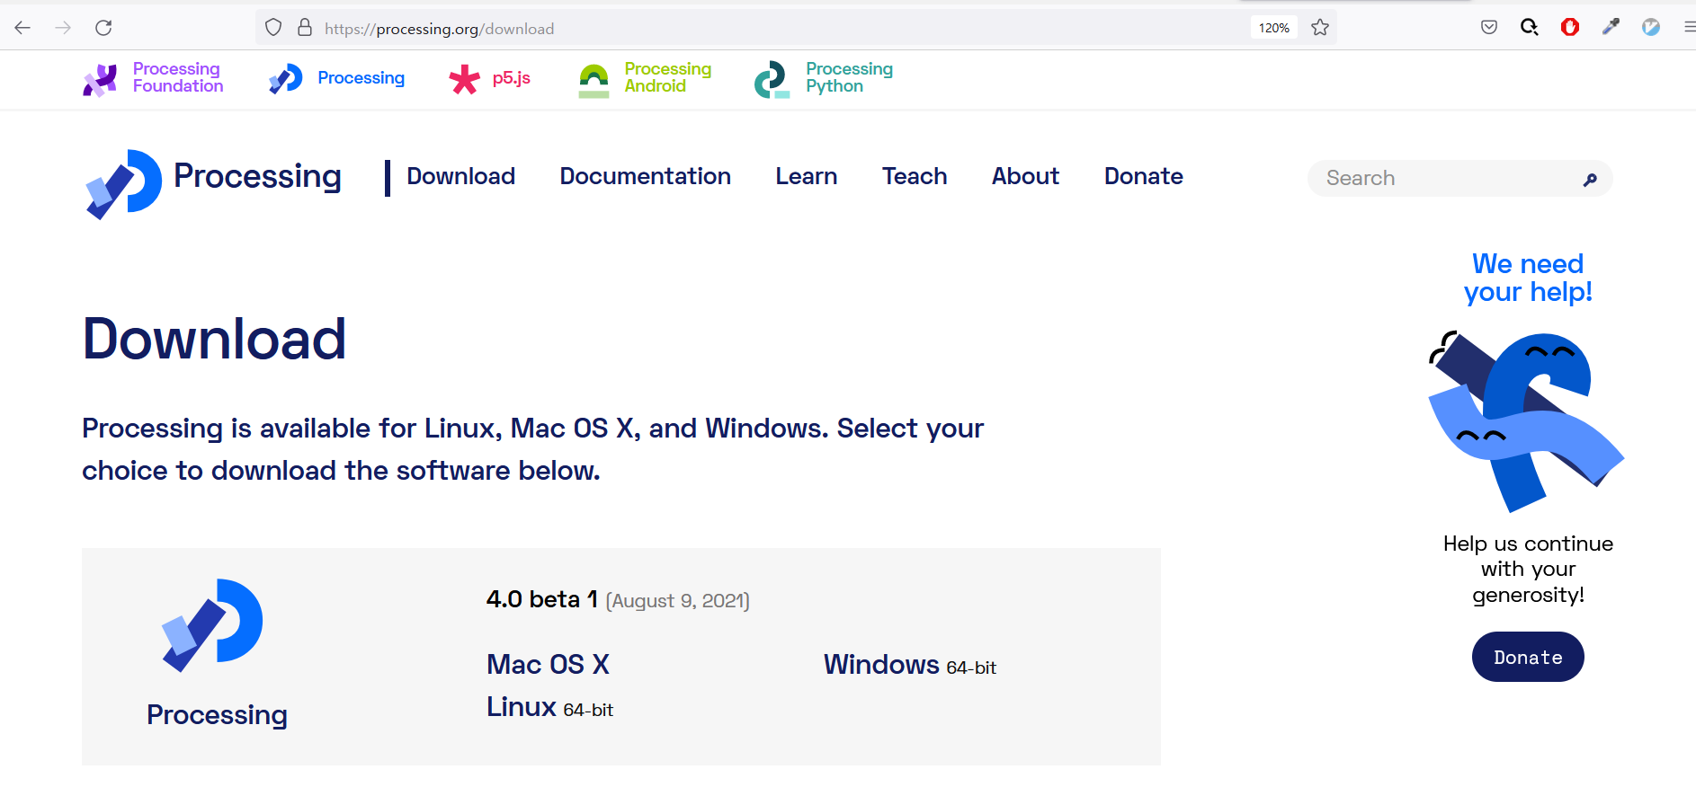
Processing IDE Installation
참고문헌: https://processing.org/download

Slide 3
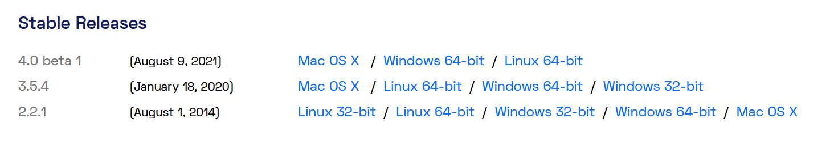
Processing IDE Installation
Version 3.5.4
참고문헌: https://processing.org/download

Slide 4
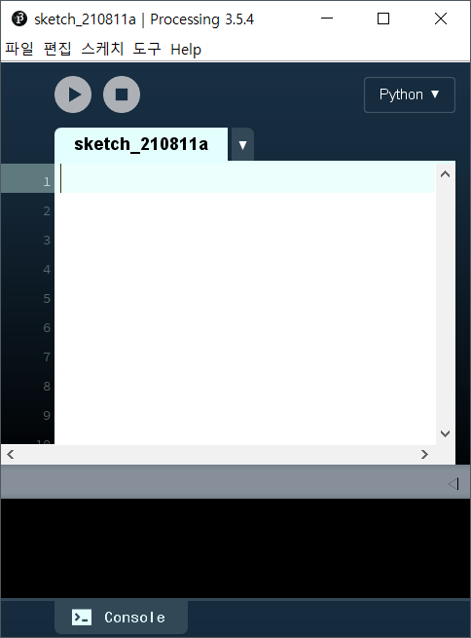
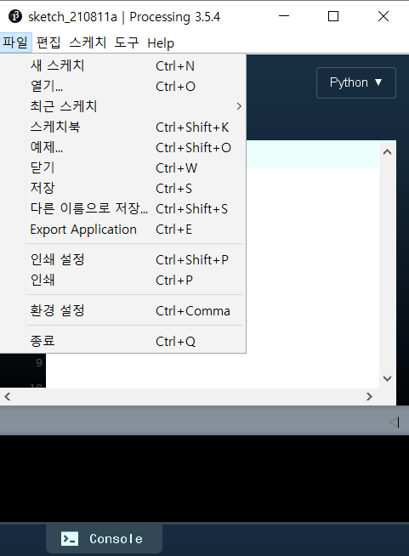
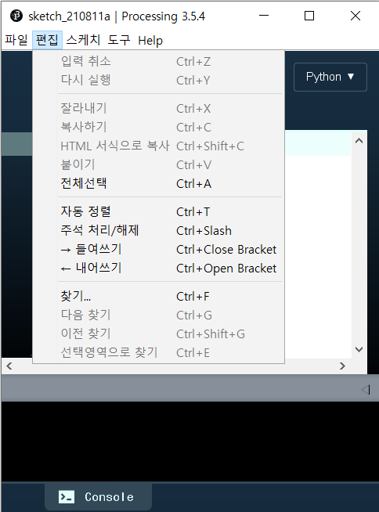
Processing IDE

Slide 5
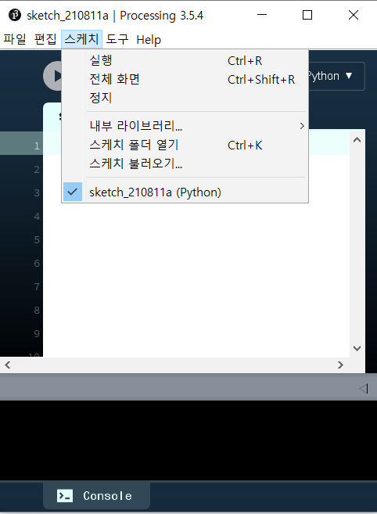
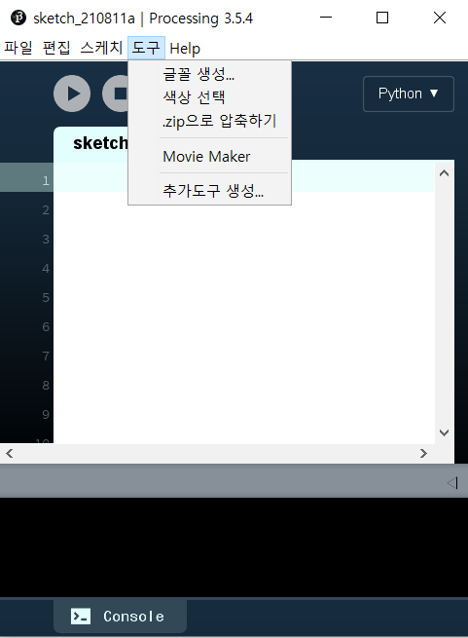
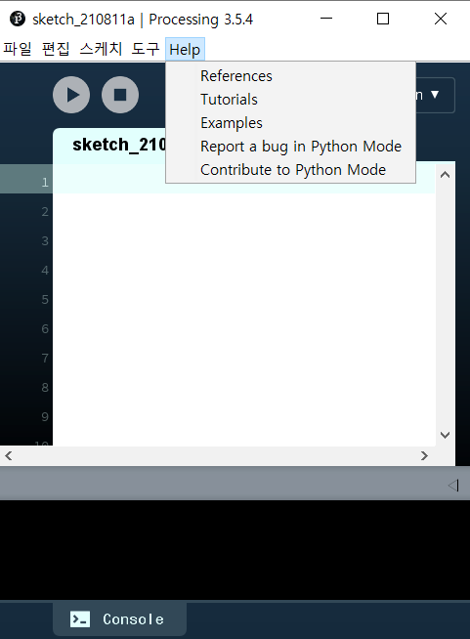
Processing IDE

